Slide 1
SagaWere Pitch Deck
SagaWere Pitch Deck

Slide 2
Our Team
ZOHAIB RAFIQUE
Muhammad Usman
Danish Safdar
BCSM-F19-349
Project Manager & Bussines Unit Manager
BCSM-F19-337
Co-founder & Finance Head
BCSM-F19-294
Technical Head
Noor Fatima
Faisal Khalid
Muhammad Irfan
BCSM-F19-221
Marketing Head
BCSM-F19-342
UI/UX designer
BCSM-F19-365
Developer

Slide 3

OUR COMPANY SoftEnu
Our Company SoftEnu Launching a Desktop Application for gamers to change the trend of gaming.

Slide 4

Sagawere
Sagawere is gaming software use for playing games in virtual environment with your hand gestures and body motion. Sagawere provides virtual controllers for different games of which user can easily download or start to enter in virtual reality. By introducing this technology we will collaborate with Metaverse because Sagawere has capability to connect physical movement with virtual movement of Avatar.

Slide 5
CUSTOMER SEGMENT

Slide 6
TARGET MARKET
SHARE
69%
31%
34.5%
15-25 y/o
GENDER
CHILD
25-35 y/o
YOUNG
31.5%
17.7%
MIDLE
35-45 y/o
45+ y/o
16.5%

Slide 7

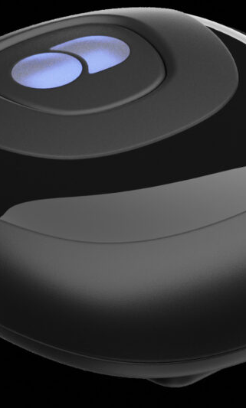

MAJOR COMPETITORS
Oculus Reality Labs is a business of Meta Platforms that produces virtual reality and augmented reality hardware and software, including virtual reality headsets such as Quest, and metaverse platforms such as Horizon Worlds.
DecaMove A company work on Locomotion in VR. Main target market is geared towards seniors and office specializes
LeapMotion Small. Fast. Accurate. World-class hand tracking for anyone, anywhere. Ultraleap’s optical hand tracking module captures the movements of your hands with unparalleled accuracy and near-zero latency.

Slide 8
Key Partners
Gamers
Game Developers
Gaming Studios
Our users or customers are gamers. The users purchase virtual triggers for better experience of games.
Game Developers are also our key partners because our software work on locomotion of gaming and will change the trend of gaming, games will develop according to the new trend of gaming.
Gaming Studios are our key partners. Games recommend our software for playing games with better virtual experience.

Slide 9
Key Resources
Software Developers: Software developers and trigger designers are our key resources
1
TOP RATED VALUES
01
2
Desktop Application and Website: Sagawere is Desktop Application based software and user can easily download it on our website
02
03
04
Platform: Our Software provide platform for gamers
3

Slide 10
Value Propositions
1
Lower Price
2
Easily configurable
3
Provide reality experience
4
New inventions

Slide 11
Statistics Of Video Gaming In Pakistan
Revenue in the Video Games segment is projected to reach US$190.70m in 2021.
Revenue is expected to show an annual growth rate (CAGR 2022-2026) of 2.17%, resulting in a projected market volume of US$227.40m by 2026.
In the Video Games segment, the number of users is expected to amount to 50.9m users by 2026.
User penetration will be 16.0% in 2022 and is expected to hit 20.6% by 2026.
The largest segment is Mobile Games with a market volume of US$171.30m in 2022.
In global comparison, most revenue will be generated in China (US$55,570.00m in 2022).
The average revenue per user (ARPU) in the Video Games segment is projected to amount to US$5.67 in 2022.

Slide 12
REVENUE STREAM
1
Subscription
2
Freemium
3
Sponsorship
4
Advertising
15%
45%
35%
5%

Slide 13
Subscription PLAN
1
10$ (Some of the Basic will unlocked)
2
15$ (All Controllers unlocked, But Low Accuracy)
3
20$ (All Controllers unlocked, High Accuracy)

Slide 14
COST STRUCTURE
Starting Capital: Rs.1,070,000
1 Month Revenue: Rs. 200,000
1 Year Profit: Rs. 7,600,000
Payback Period: 2.23 Months

Slide 15
Channels
Google Adsen
We will advertise our business through Paid Advertisement
YouTube
We will advertise our business through YouTube
Social Media
Website
We will advertise our business through Facebook, Instagram
We will advertise our business through our website (https://sagawere.blogspot.com/)

Slide 16
THANKS

